Slide 1
2020 DATA SCIENCE PROJECT
DS Term Project Final Presentation
TEAM1
201433701 이성욱
201433268 박헌태
201533308 이찬하

Slide 2

Objective setting
Data curation & Inspection
Data Preprocessing
Data Analysis
Data Evaluation
Result
Role

Slide 3
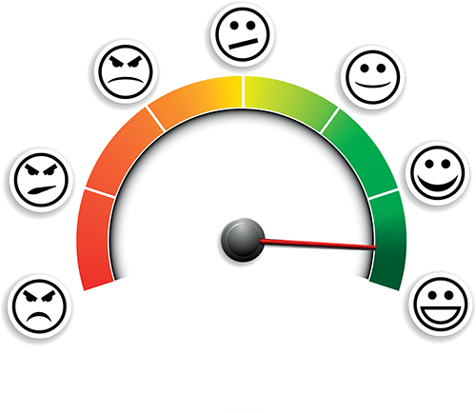
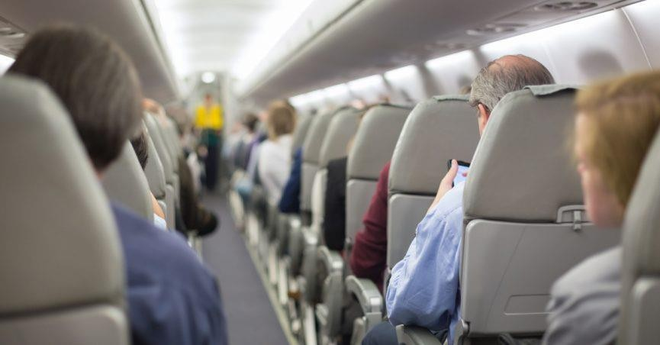
1. Objective Setting
We selected features that are related to satisfaction. And use selected features to classify passenger’s satisfaction. These results will show the satisfaction of the passenger and tell them what is relevant to satisfaction and these results will contribute to the development of airline services.

Slide 4
Data Dictionary
Gender: Gender of the passengers (Female, Male)
Customer Type: The customer type (Loyal customer, disloyal customer)
Age: The actual age of the passengers
Type of Travel: Purpose of the flight of the passengers (Personal Travel, Business Travel)
Class: Travel class in the plane of the passengers (Business, Eco, Eco Plus)
Flight distance: The flight distance of this journey
Inflight wifi service: Satisfaction level of the inflight wifi service (0:Not Applicable;1-5)
Departure/Arrival time convenient: Satisfaction level of Departure/Arrival time convenient
Ease of Online booking: Satisfaction level of online booking
Gate location: Satisfaction level of Gate location
Food and drink: Satisfaction level of Food and drink
Online boarding: Satisfaction level of online boarding
Seat comfort: Satisfaction level of Seat comfort
Inflight entertainment: Satisfaction level of inflight entertainment
On-board service: Satisfaction level of On-board service
Leg room service: Satisfaction level of Leg room service
Baggage handling: Satisfaction level of baggage handling
Check-in service: Satisfaction level of Check-in service
Inflight service: Satisfaction level of inflight service
Cleanliness: Satisfaction level of Cleanliness
Departure Delay in Minutes: Minutes delayed when departure
Arrival Delay in Minutes: Minutes delayed when Arrival
Satisfaction: Airline satisfaction level(Satisfaction, neutral or dissatisfaction)

Slide 5
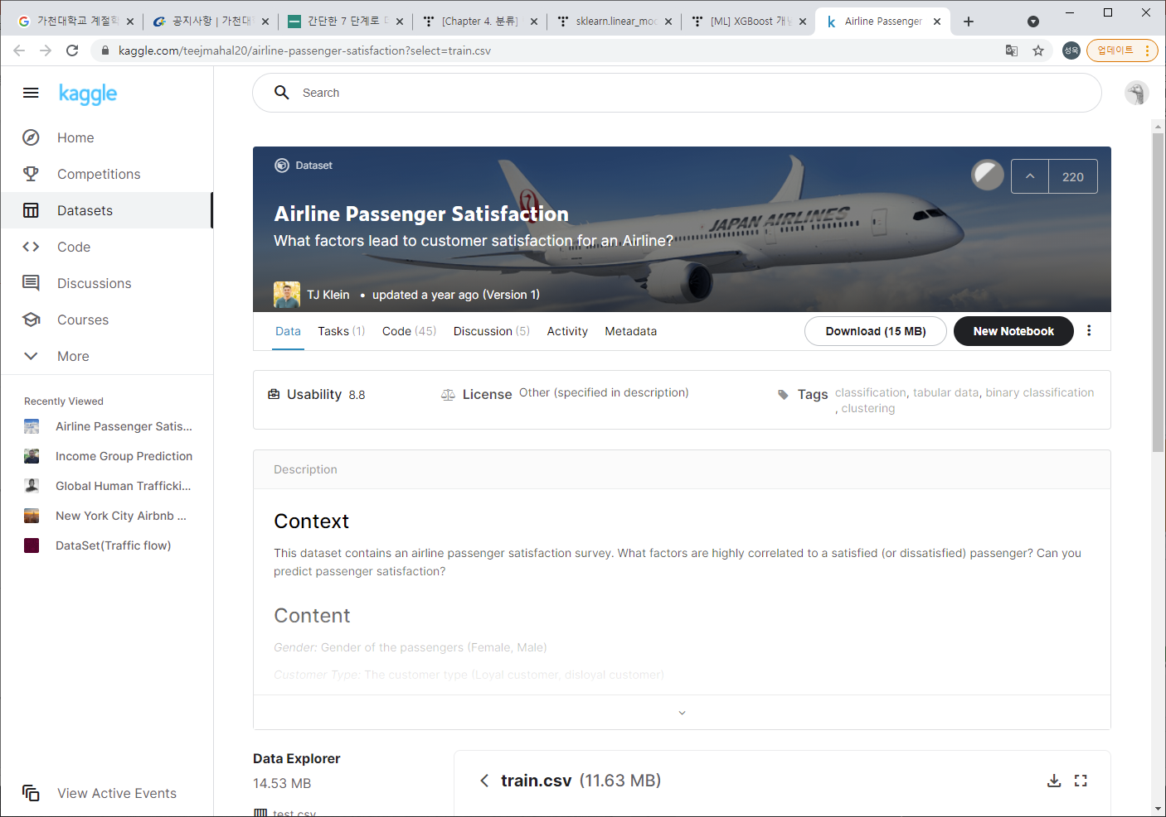
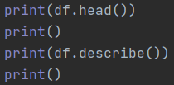
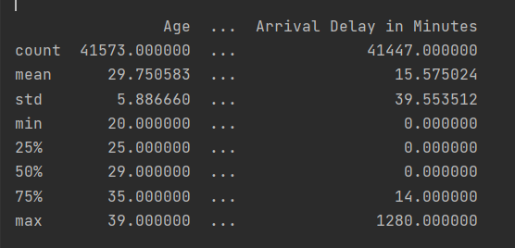
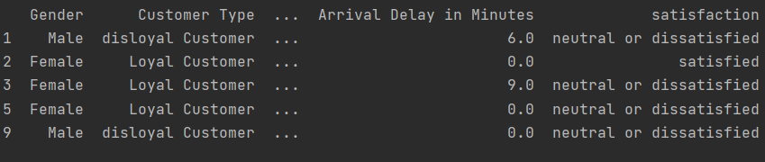
2. Data curation & Inspection
Data Curation
Collect Airline passenger’s satisfaction data form Kaggle.

Slide 6
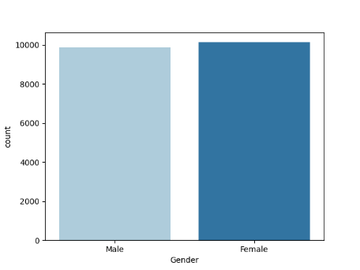
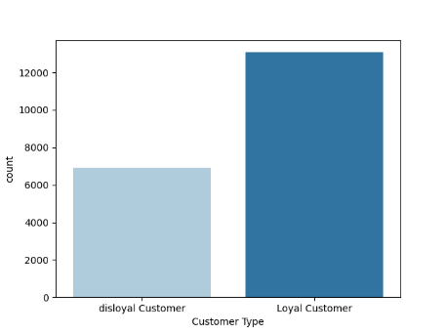
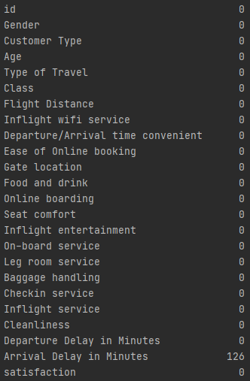
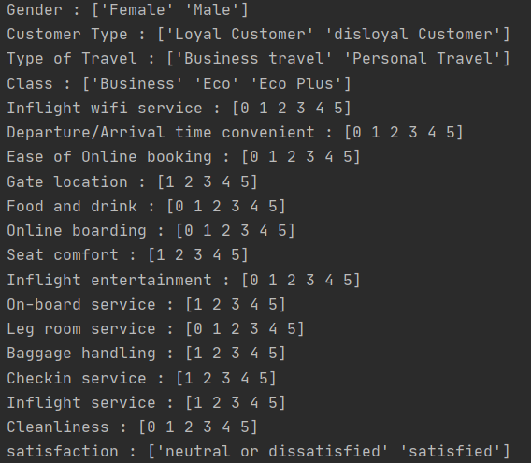
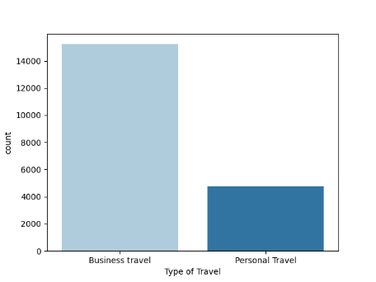
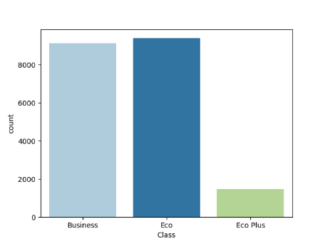
2. Data curation & Inspection
Data Inspection

Slide 7
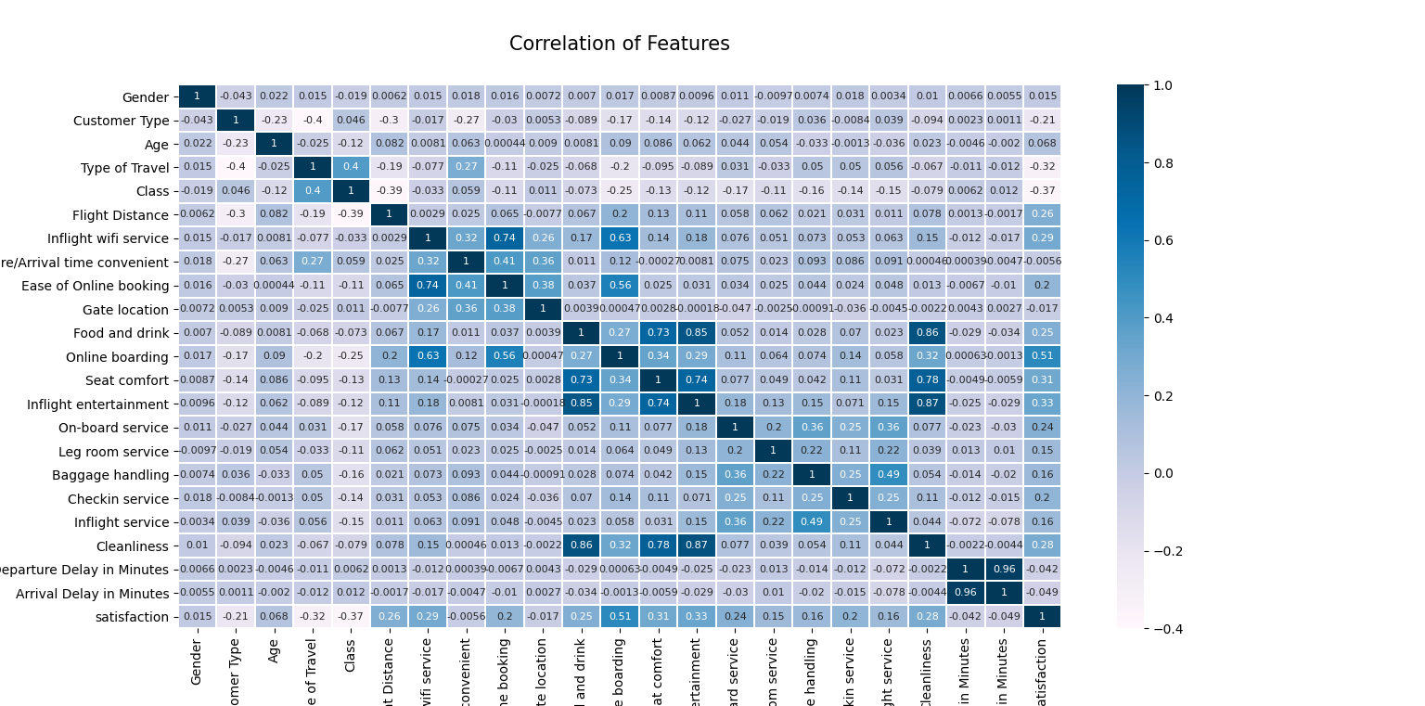
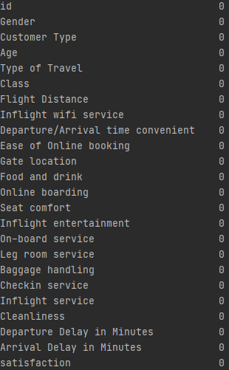
3. Data Preprocessing
Correlation of each features
Dropping Dirty Data
Before
After

Slide 8
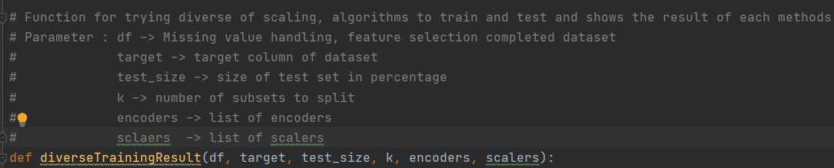
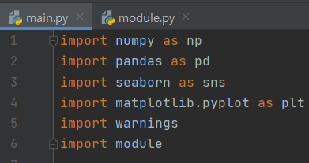
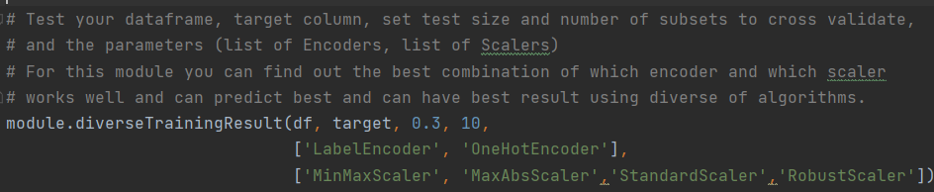
3. Data Preprocessing
Modulization

Slide 9
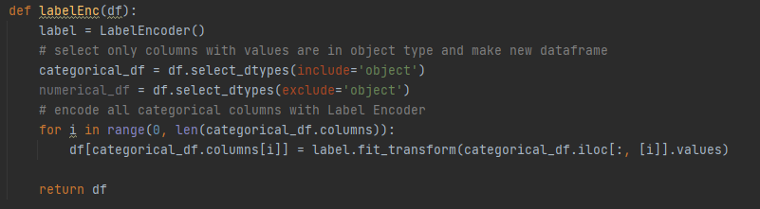
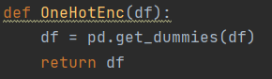
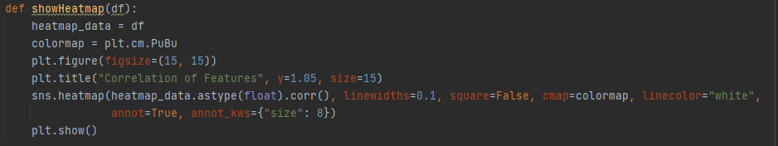
3. Data Preprocessing
Modulization

Slide 10
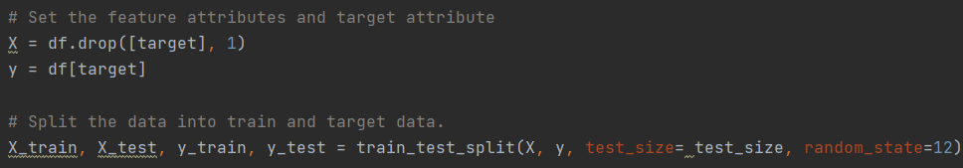
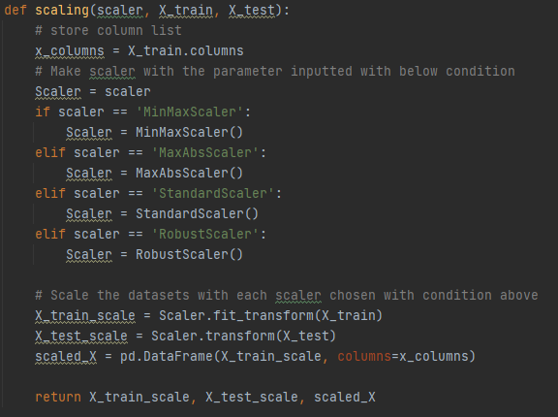
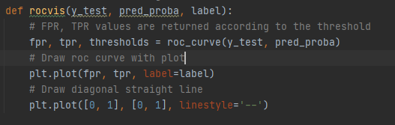
3. Data Preprocessing
Modulization

Slide 11
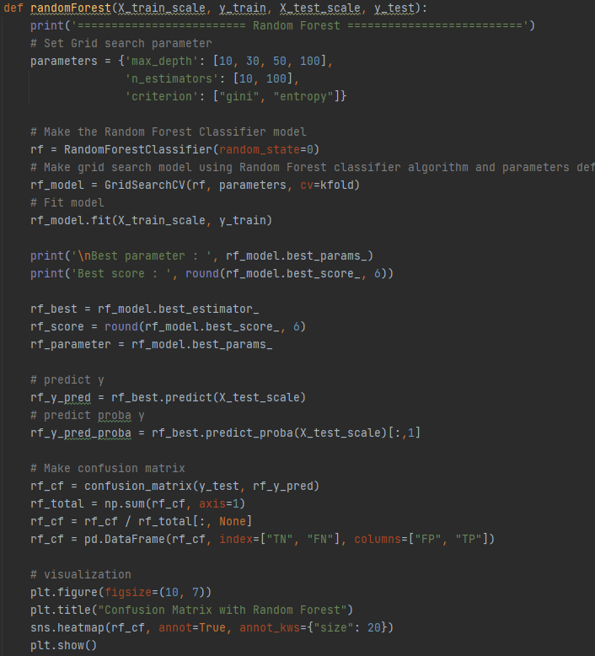
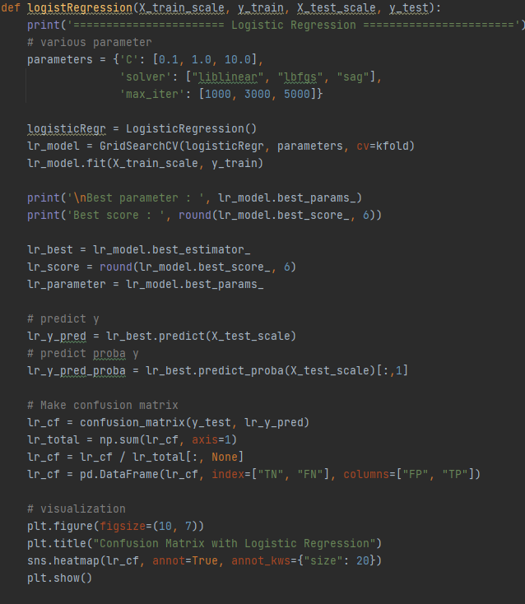
3. Data Preprocessing
Modulization

Slide 12
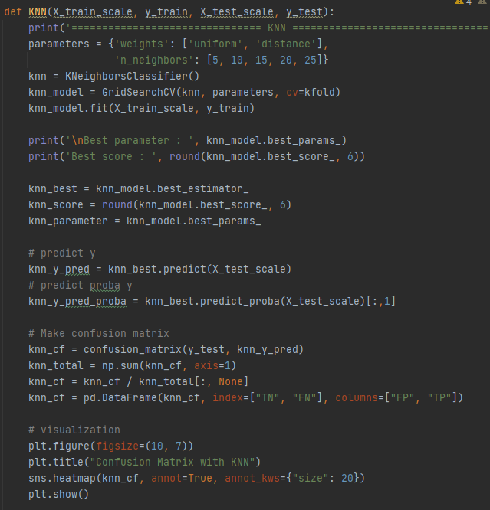
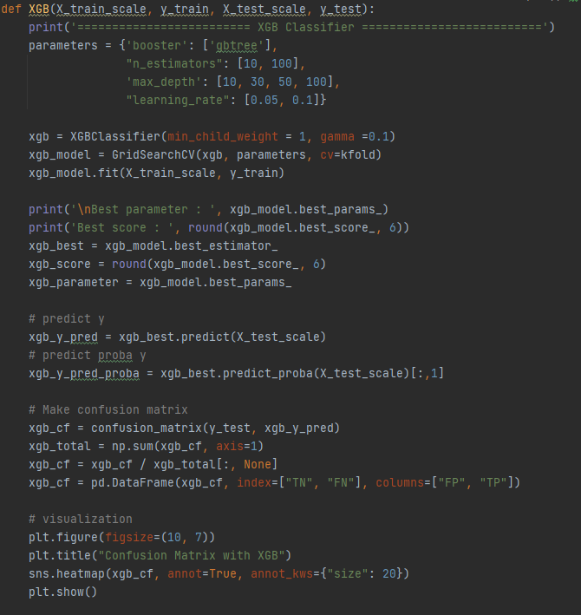
3. Data Preprocessing
Modulization

Slide 13
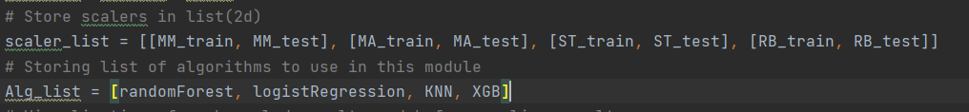
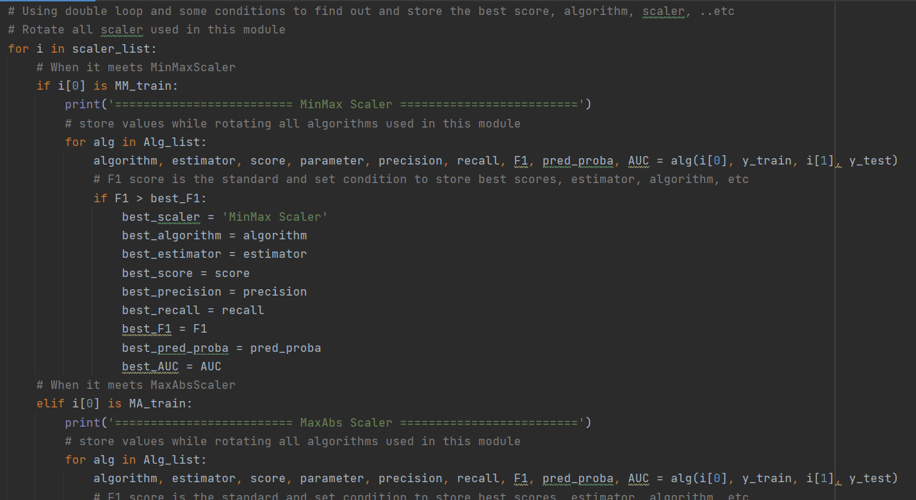
3. Data Preprocessing
Modulization

Slide 14
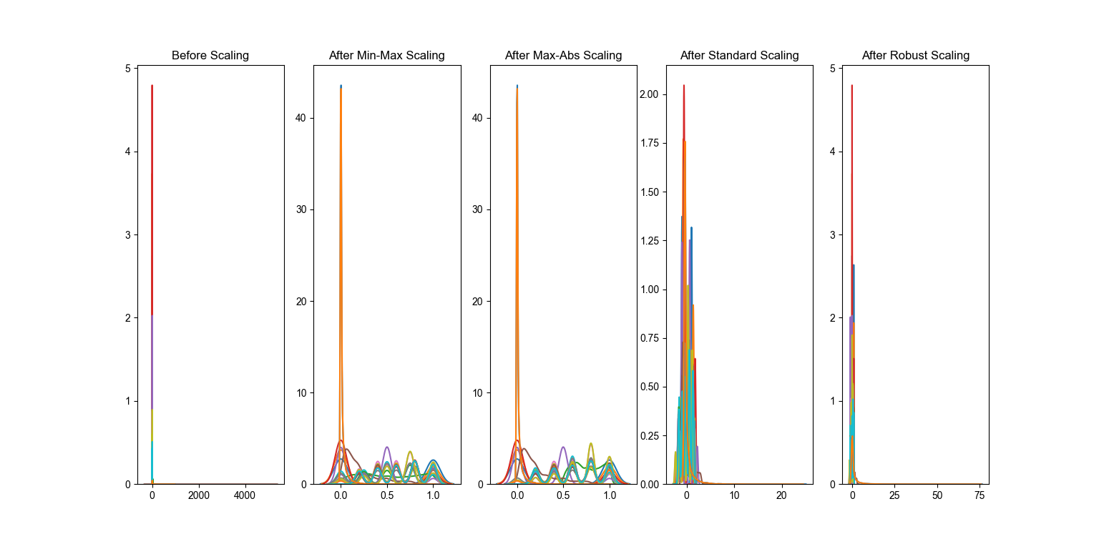
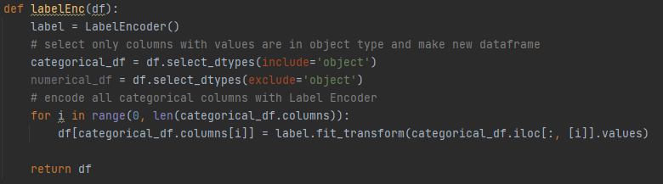
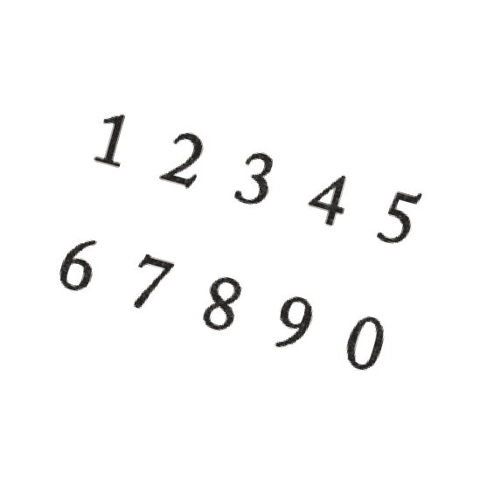

3. Data Preprocessing
Label Encoding
Data Scaling
Categorical Value
Numeric Value
Before
After

Slide 15
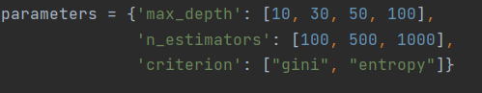
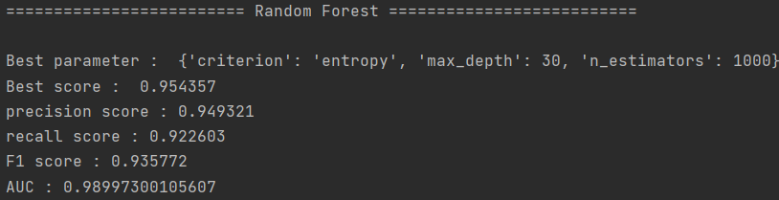
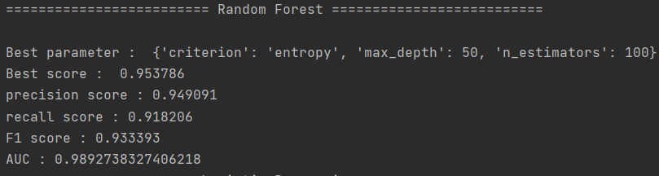
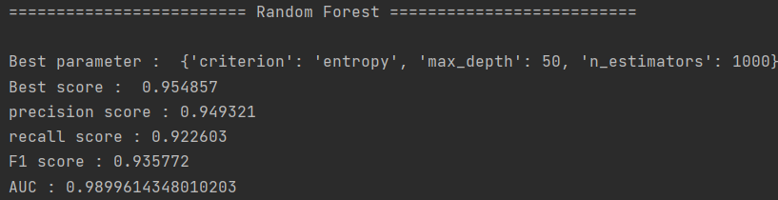
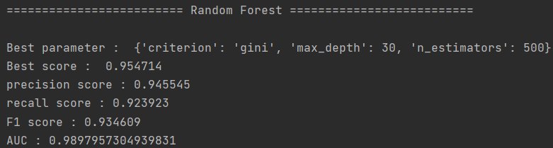
4. Data Analysis
Random Forest
Max-Abs scaling
Robust scaling
Min-Max scaling
Standard scaling

Slide 16
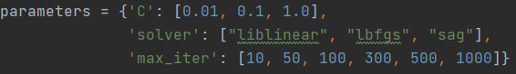
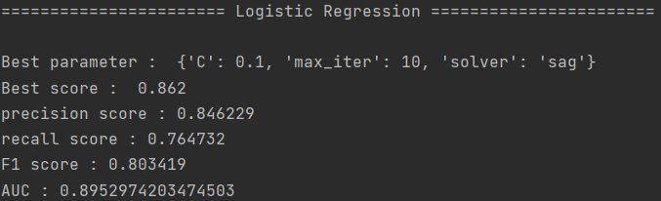
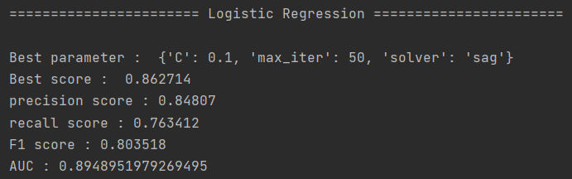
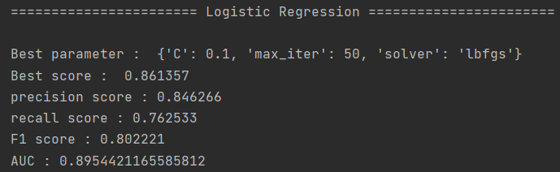
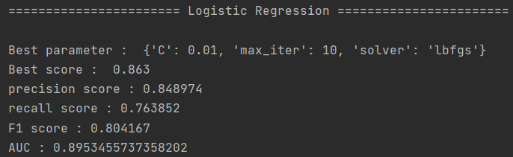
4. Data Analysis
Logistic Regression
Max-Abs scaling
Robust scaling
Min-Max scaling
Standard scaling

Slide 17
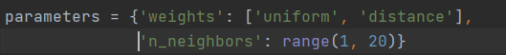
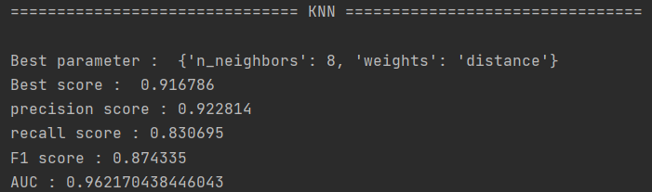
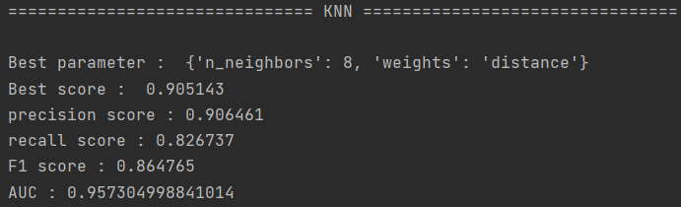
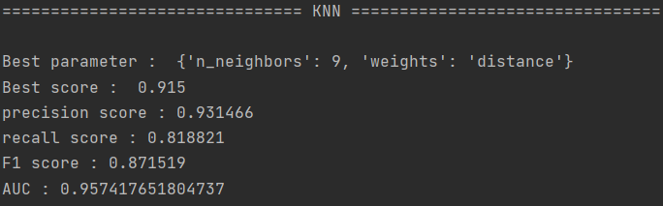

4. Data Analysis
KNN
Max-Abs scaling
Robust scaling
Min-Max scaling
Standard scaling

Slide 18
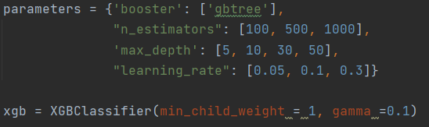
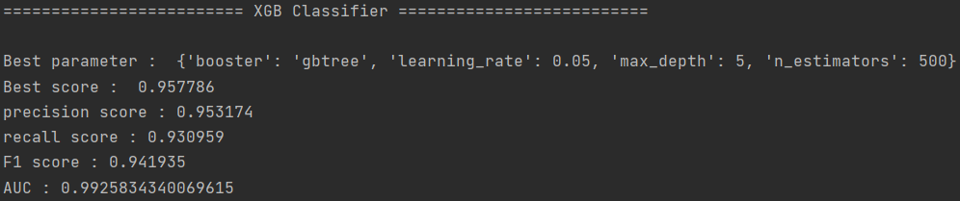
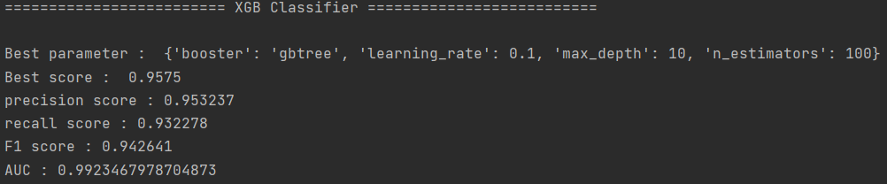
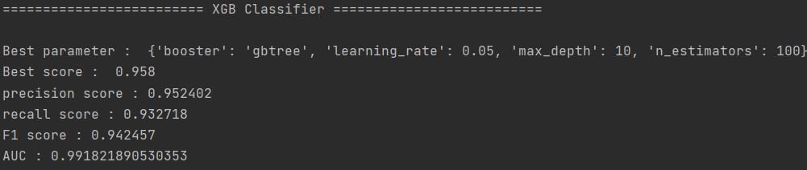

4. Data Analysis
XGB
Max-Abs scaling
Robust scaling
Min-Max scaling
Standard scaling

Slide 19








5. Data Evaluation
Confusion Matrix
Random Forest
Min-Max scaling
Max-Abs scaling
Standard scaling
Robust scaling
Logistic Regression
Min-Max scaling
Max-Abs scaling
Standard scaling
Robust scaling

Slide 20








5. Data Evaluation
Confusion Matrix
KNN
Min-Max scaling
Max-Abs scaling
Standard scaling
Robust scaling
XGB
Min-Max scaling
Max-Abs scaling
Standard scaling
Robust scaling

Slide 21


6. Result

Slide 22

7. Role
박현태
이성욱
이찬하
Data Preprocessing
Evaluation
Modulization
Objective Setting
Data Curation
Data Analysis
Data Inspection
& Deployment

Slide 23
Q & A

Slide 24
Thank you

